Slide 1
I Com Arm - Kneecap

Slide 2
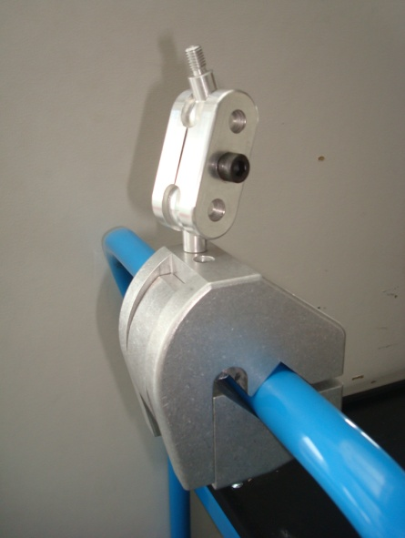
This system is very use by heavily handicapped people, who need a articulate arm for their chair.
Indeed, fixed to a handle, it allow to change the position of some steering device.

Slide 3
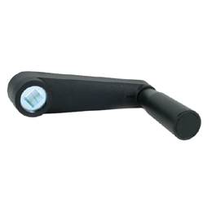
Goal :
Design a system for manual locking

Slide 4
Specifications
No tool should be used to block the system.
Tightening should be possible with only one hand.
The same system must be used to block the clips on the armchair.
Time: 8 hours.

Slide 5
Our project

Slide 6
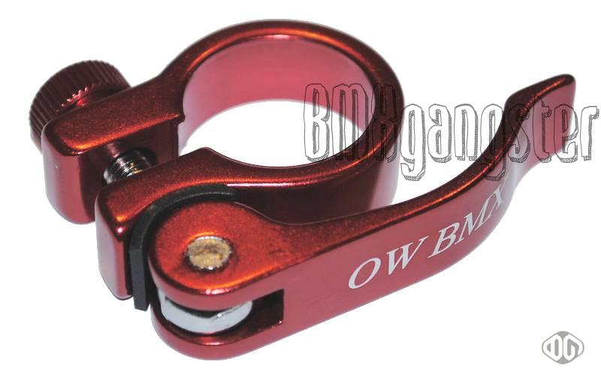
Ideas
Wheel
Seat clamps
Large bolt
Crank
After a brainstorming, we have stop our choice on the crank because it’s easier to make.

Slide 7
Problems
Lengthen the crank
Add a hole for the bolt
Sometimes, the pc has crashed.
Lack of time

Slide 8
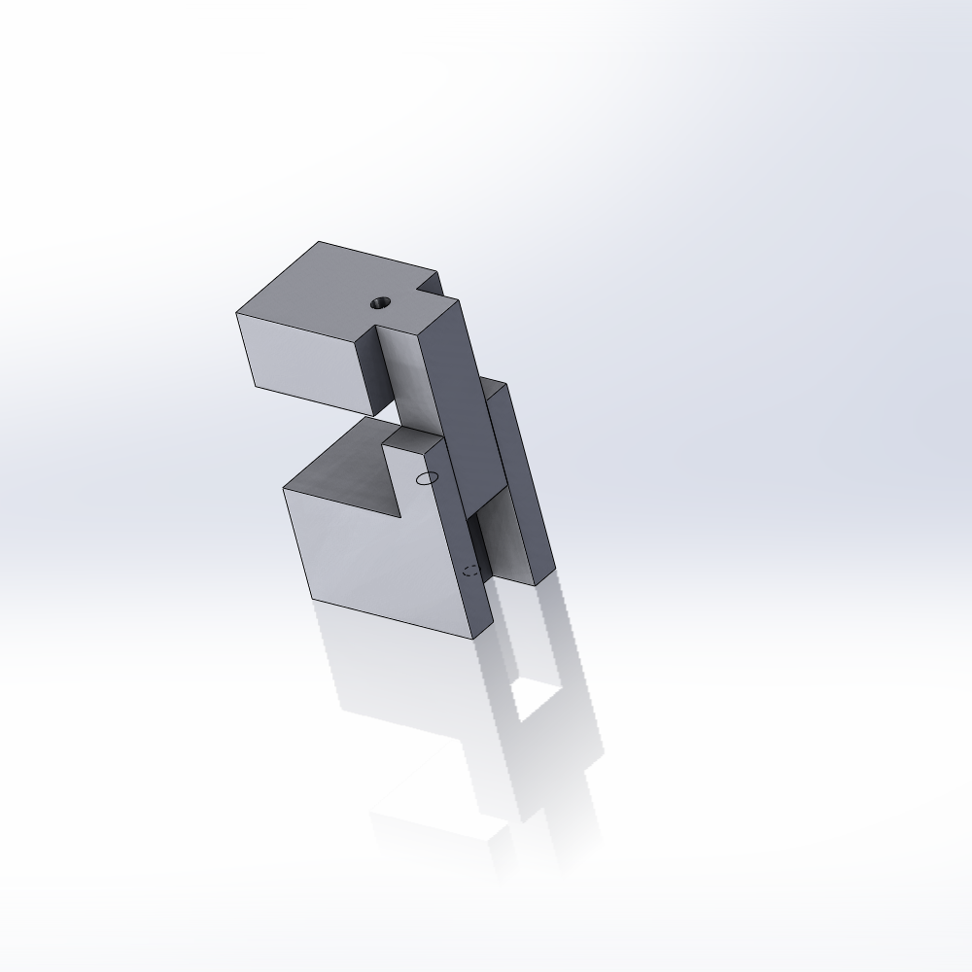
Log book
First we have made freehand drawings
and we have taken measures.
Then we have used
solidworks for
realized parts.
We have products
the nippers with
threaded holes.

Slide 9
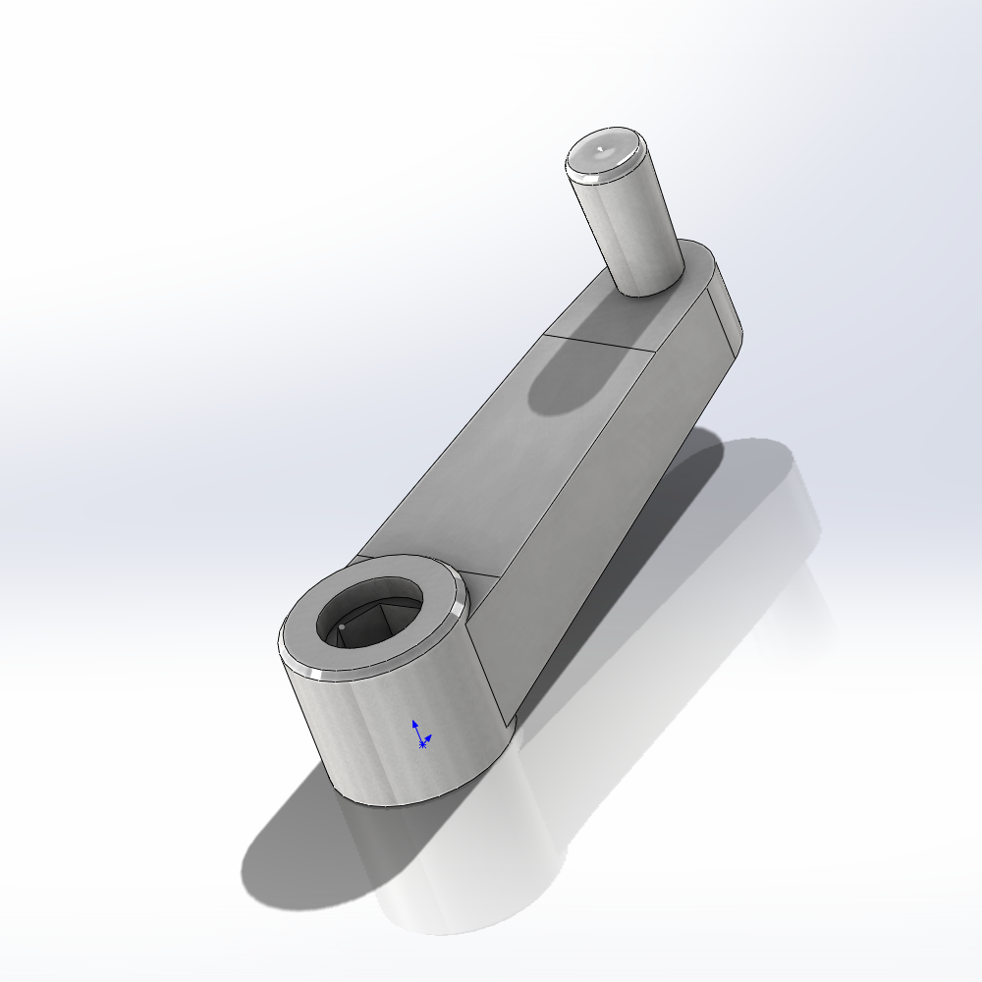
The crank :
30mm diameter

Slide 10
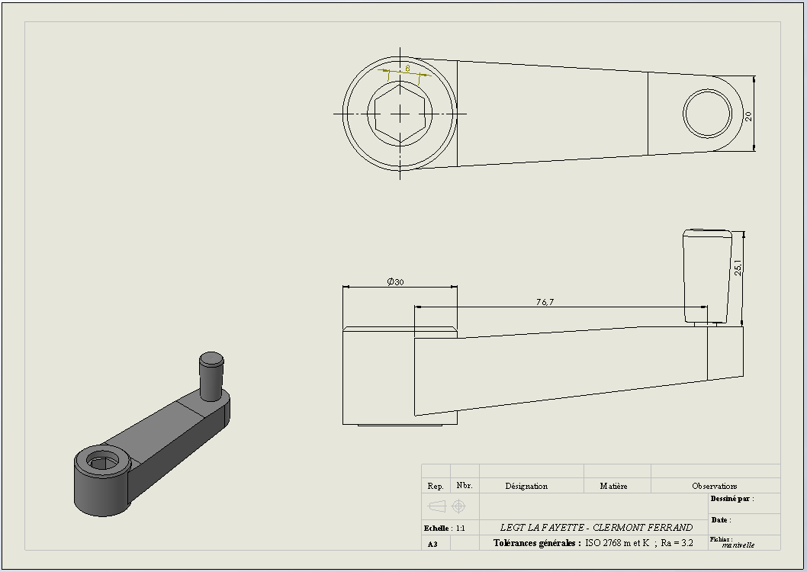

Slide 11
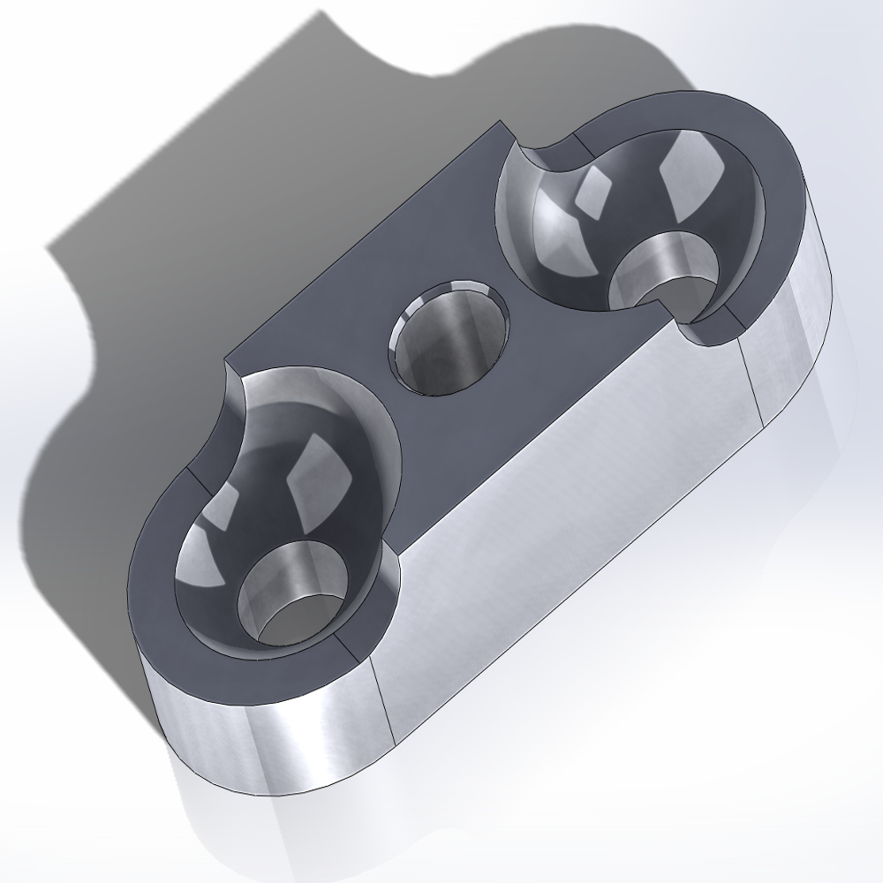
The Case :

Slide 12
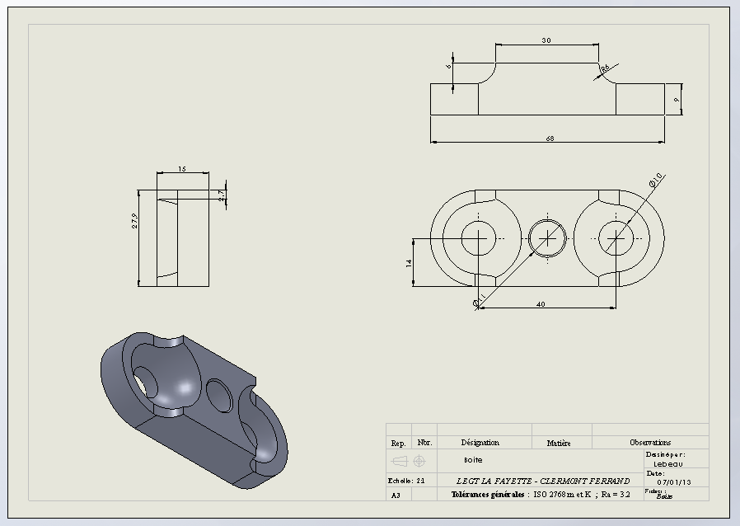
The Case

Slide 13
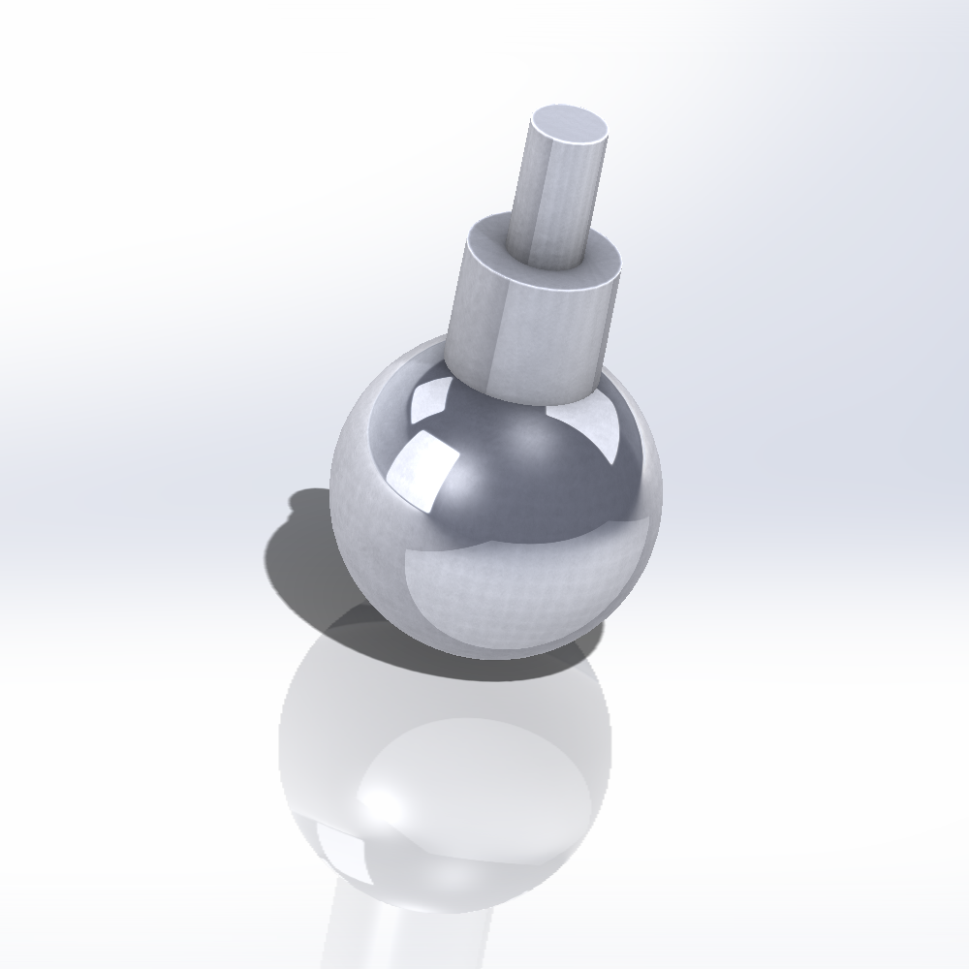
Balls screws in the housing

Slide 14
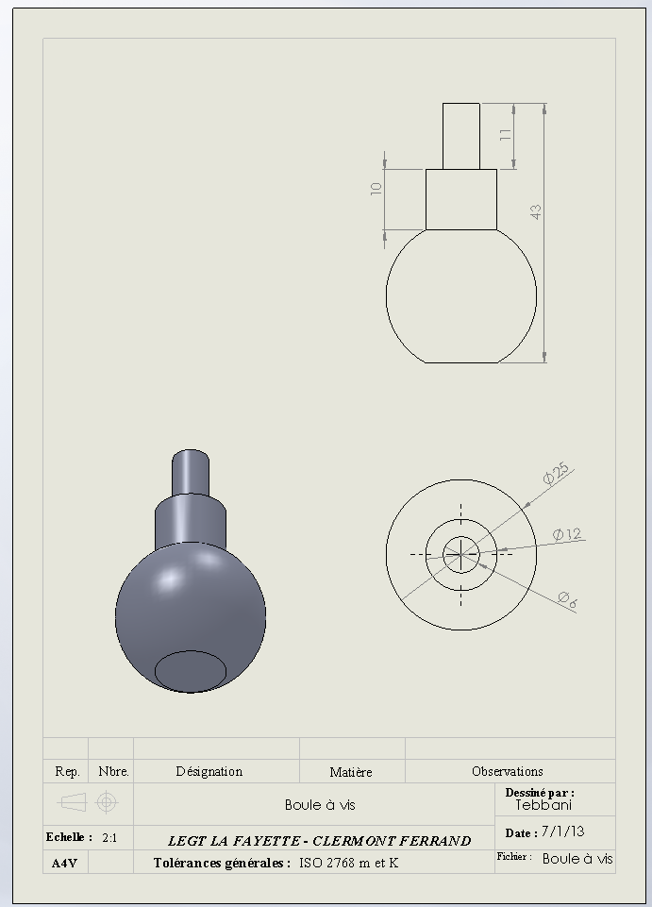

Slide 15
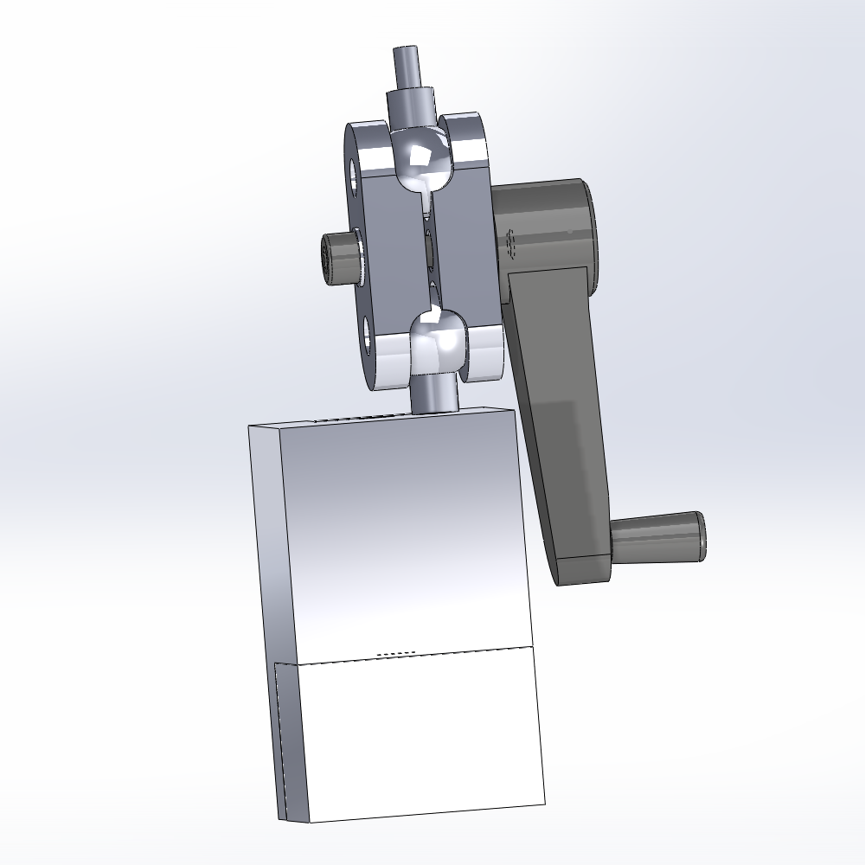
Then we made drawing and assembly …

Slide 16
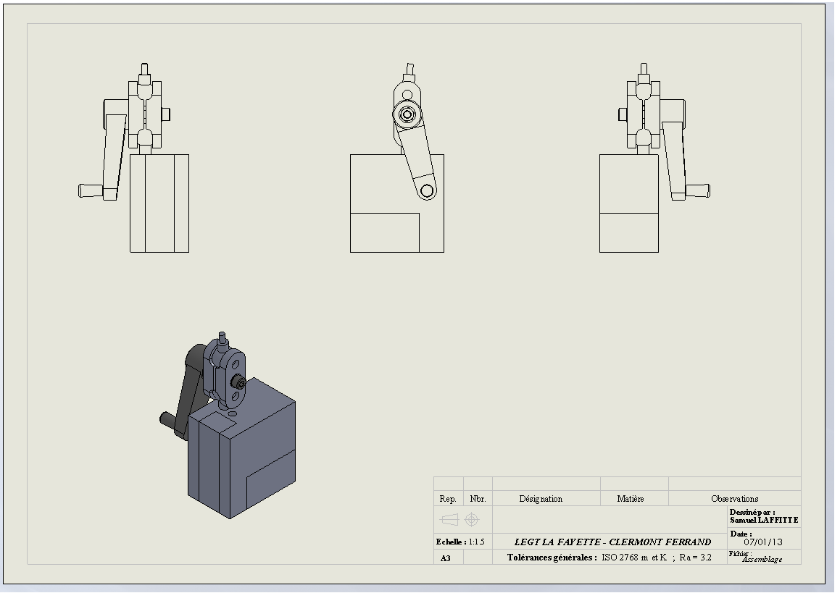
Drawing setting … (MEP)

Slide 17
Test
After the making of the prototype on 3D printer, we have tested the project.
But after 5 minutes of usage, the crank has broken.
So we made a hole and repair the handle with a screw.

Slide 18
Conclusion
No tool should be used to block the system: aquired
Tightening should be possible with only one hand: aquired
The same system must be used to block the clips on the armchair : don’t know
So our project no respect all of the specification.

